Slide 1
Data Analysis & Modeling Techniques
Random Processes

Slide 2
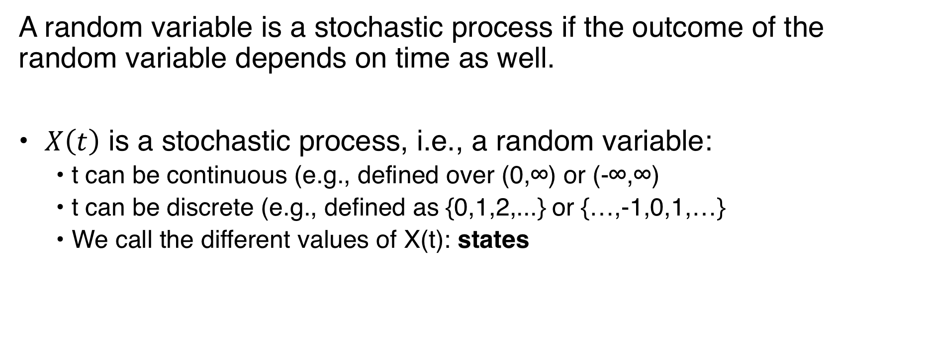
Stochastic Process
A random variable is a stochastic process if the outcome of the random variable depends on time as well.
• $X\left(t\right)$ is a stochastic process, i.e., a random variable:
  • t can be continuous (e.g., defined over (0,∞) or (-∞,∞)
  • t can be discrete (e.g., defined as {0,1,2,...} or {…,-1,0,1,…}
  • We call the different values of X(t): states

Slide 3
Discrete and Continuous
State:
X(t) can be discrete-state
  Outcomes of X take values fro ma discrete set
X(t) can be continuous state
  Outcomes of X take values over (a) continuous interval(s)
Time:
X(t) can be discrete-time process
  Time is discrete, i.e., t is an integer
X(t) can be continuous-time process
  Time is continuous, process may change at any time

Slide 4
Markov processes and Markov chains
MARKOV STOCHASTIC
PROCESSES

Slide 5
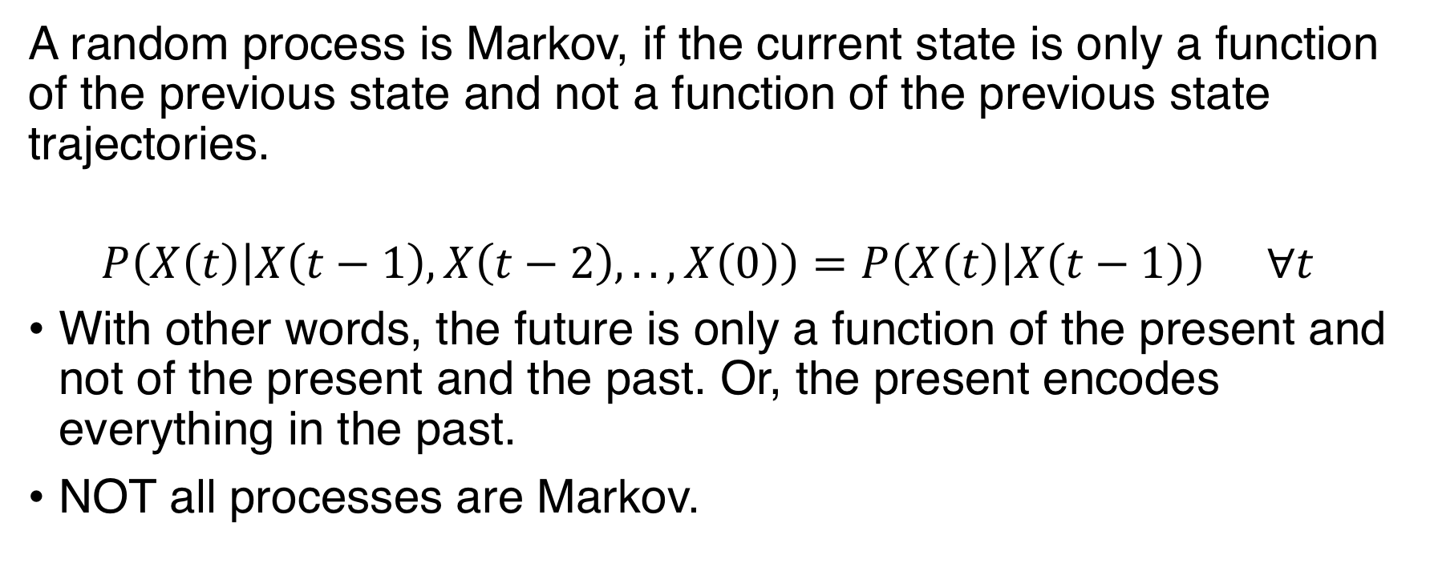
Markov Properties
A random process is Markov, if the current state is only a function of the previous state and not a function of the previous state trajectories.
$$P\left(X\left(t\right) | X\left(t−1\right),X\left(t−2\right),..,X\left(0\right)\right)=P\left(X\left(t\right) | X\left(t−1\right)\right) ∀t$$
With other words, the future is only a function of the present and not of the present and the past. Or, the present encodes everything in the past.
NOT all processes are Markov.

Slide 6
Markov Chain
Markov chain is a discrete-time discrete state Markov process.
• Easy to represent graphically.
• State progression: X(0), X(1), X(2), …
• Thus {X(0), X(1), X(2) ,…} is a random sequence

Slide 7
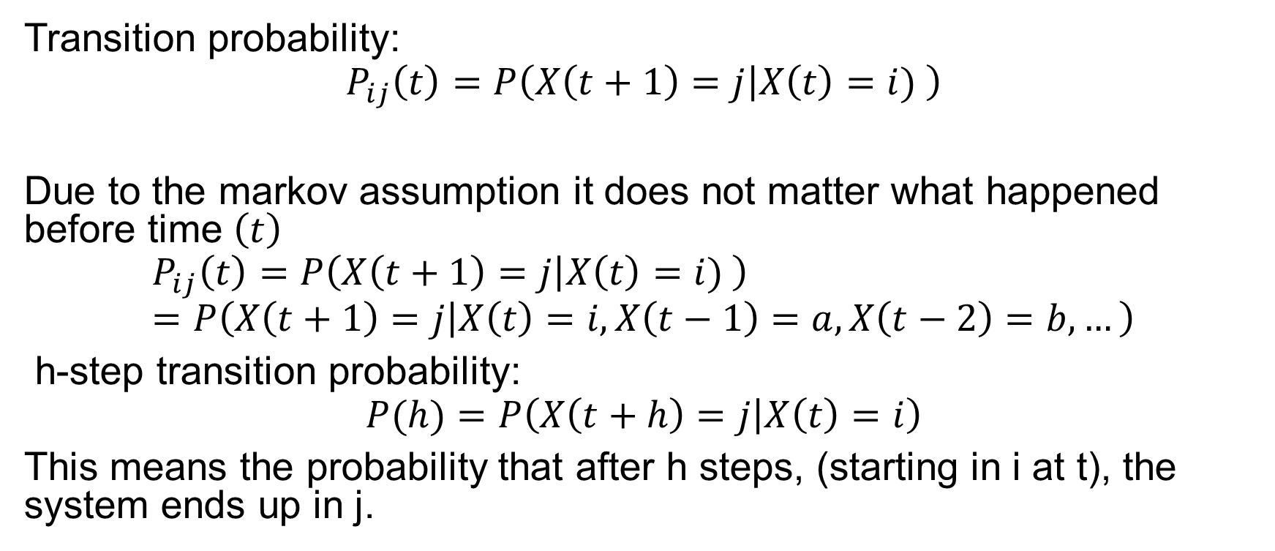
Transition Probability
Transition probability:
$$P_{ij}\left(t\right)=P\left(X\left(t+1\right)=j | X\left(t\right)=i) \right)$$
Due to the markov assumption it does not matter what happened before time $\left(t\right)$
$$P_{ij}\left(t\right)=P\left(X\left(t+1\right)=j | X\left(t\right)=i) \right)=P\left(X\left(t+1\right)=j | X\left(t\right)=i,X\left(t−1\right)=a,X\left(t−2\right)=b,…\right)$$
h-step transition probability:
$$P(h)=P\left(X\left(t+h\right)=j | X\left(t\right)=i\right)$$
This means the probability that after h steps, (starting in i at t), the system ends up in j.

Slide 8
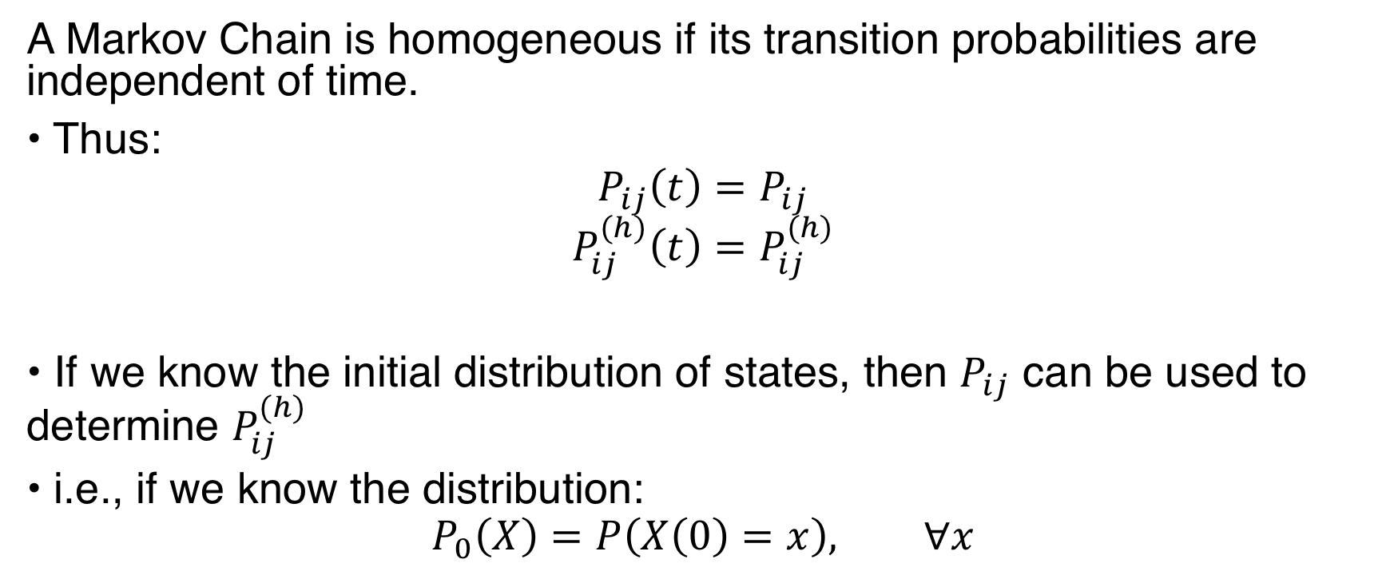
Homogeneous Markov Chain
A Markov Chain is homogeneous if its transition probabilities are independent of time.
• Thus:
$$P_{ij}\left(t\right)=P_{ij}$$
$$P_{ij}^{(h)}\left(t\right)=P_{ij}^{(h)}$$
• If we know the initial distribution of states, then $P_{ij}$ can be used to determine $P_{ij}^{(h)}$
• i.e., if we know the distribution:
$$P_{0}\left(X\right)=P\left(X\left(0\right)=x\right), ∀x$$

Slide 9
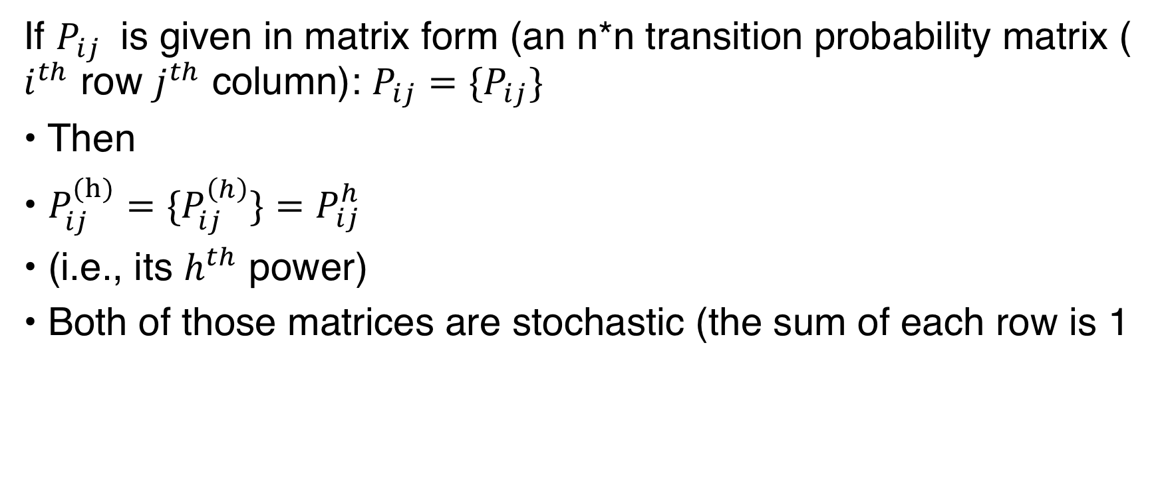

Computing $P_{ij}^{(h)}$
If $P_{ij}$ is given in matrix form (an n*n transition probability matrix ( $i^{th}$ row $j^{th}$ column): $P_{ij}=\{P_{ij}\}$
• Then
• $P_{ij}^{(h)}=\{P_{ij}^{\left(h\right)}\}=P_{ij}^{h}$
• (i.e., its $h^{th}$ power)
• Both of those matrices are stochastic (the sum of each row is 1

Slide 10
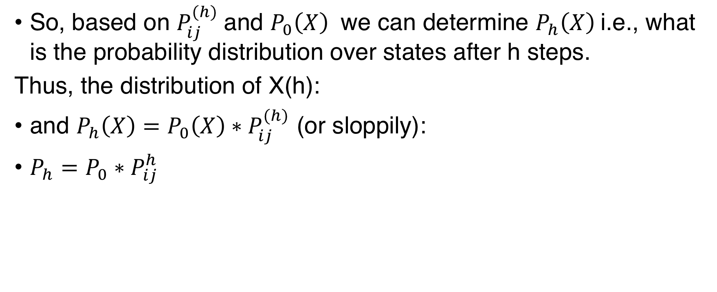
State Distribution After h steps
So, based on $P_{ij}^{(h)}$and $P_{0}\left(X\right)$ we can determine $P_{h}\left(X\right)$i.e., what is the probability distribution over states after h steps.
Thus, the distribution of X(h):
and $P_{h}\left(X\right)={P_{0}\left(X\right)∗P}_{ij}^{(h)}$ (or sloppily):
$P_{h}={P_{0}∗P}_{ij}^{h}$

Slide 11
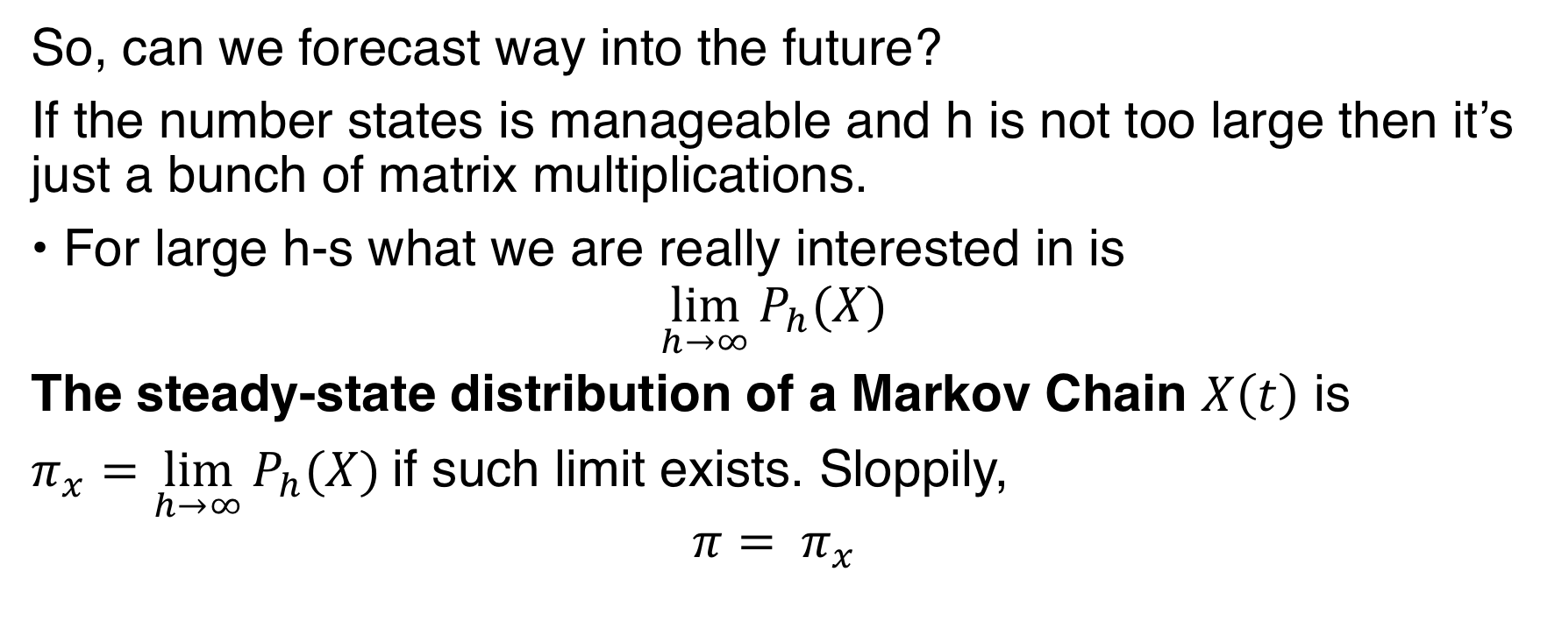
How about Large h
So, can we forecast way into the future?
If the number states is manageable and h is not too large then it’s just a bunch of matrix multiplications.
• For large h-s what we are really interested in is
$$\lim_{h→∞}{P_{h}(X)}$$
The steady-state distribution of a Markov Chain $X\left(t\right)$ is
$π_{x}=\lim_{h→∞}{P_{h}(X)}$if such limit exists. Sloppily,
$${π= π}_{x}$$

Slide 12
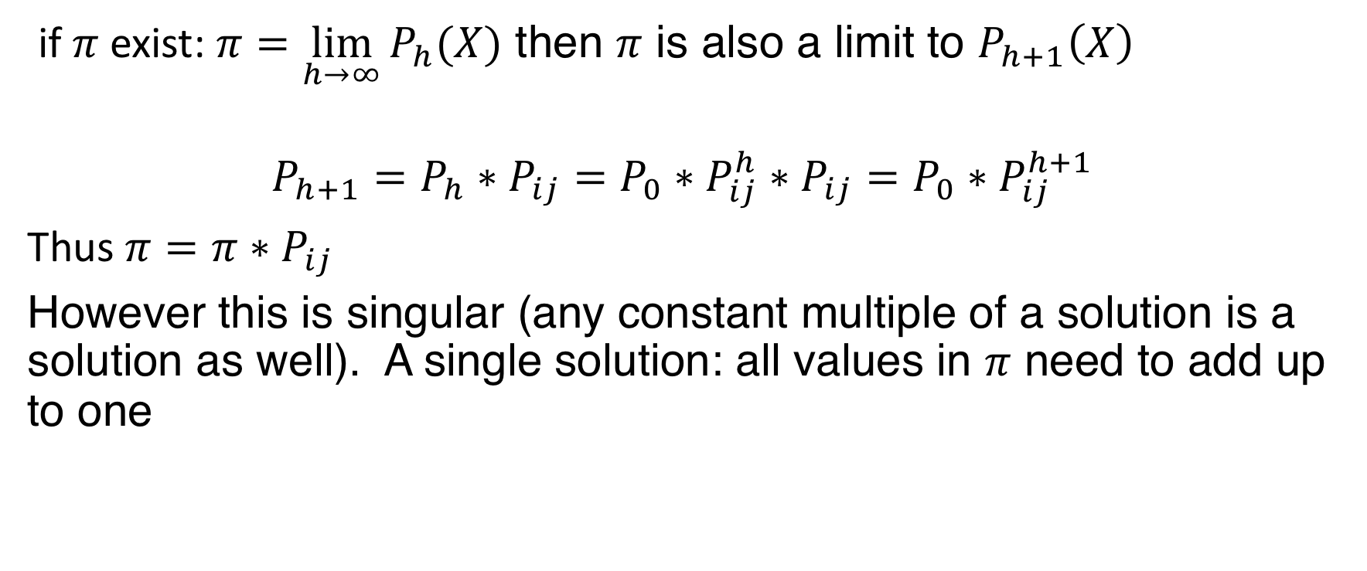
Calculating the Steady State Distribution
if $π$exist: $π=\lim_{h→∞}{P_{h}(X)}$ then $π$ is also a limit to $P_{h+1}\left(X\right)$
$$P_{h+1}=P_{h}∗P_{ij}=P_{0}∗P_{ij}^{h}∗P_{ij}=P_{0}∗P_{ij}^{h+1}$$
Thus ${π=π∗P}_{ij}$
However this is singular (any constant multiple of a solution is a solution as well). A single solution: all values in $π$ need to add up to one

Slide 13
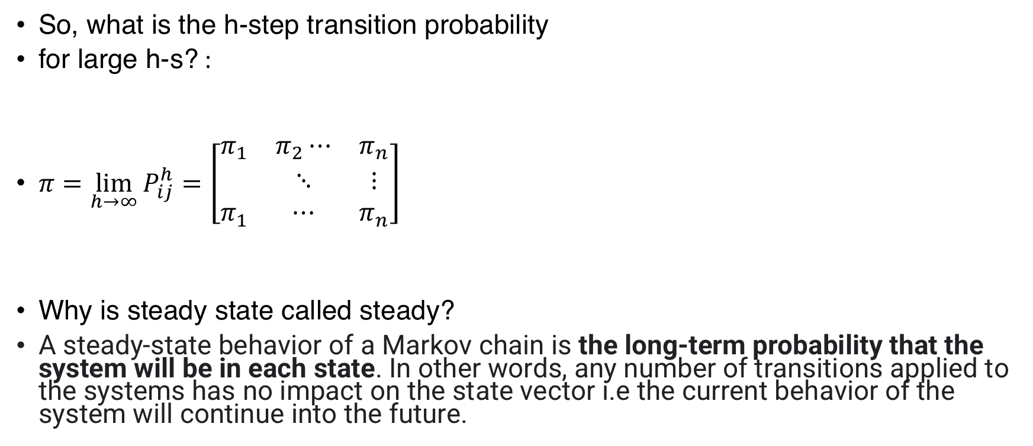
Transition Probabilities for Large h
So, what is the h-step transition probability
for large h-s? :
$π=\lim_{h→∞}{P_{ij}^{h}}=\left[\begin{matrix}π_{1} & π_{2}⋯ & π_{n} \\ & ⋱ & ⋮ \\ π_{1} & ⋯ & π_{n}\end{matrix}\right]$
Why is steady state called steady?
A steady-state behavior of a Markov chain is the long-term probability that the system will be in each state. In other words, any number of transitions applied to the systems has no impact on the state vector i.e the current behavior of the system will continue into the future.

Slide 14
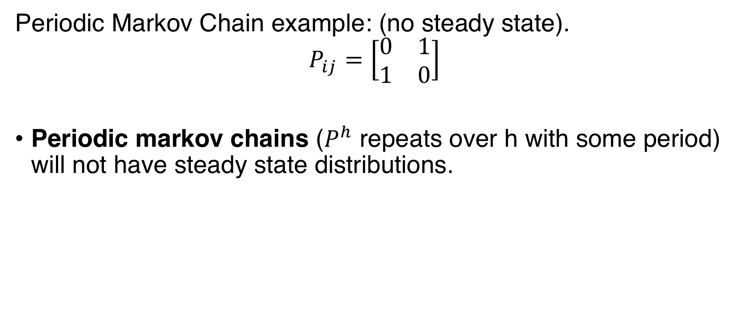
Steady State, Always?
Periodic Markov Chain example: (no steady state).
$$P_{ij}=\left[\begin{matrix}0 & 1 \\ 1 & 0\end{matrix}\right]$$
Periodic markov chains ($P^{h}$ repeats over h with some period) will not have steady state distributions.

Slide 15
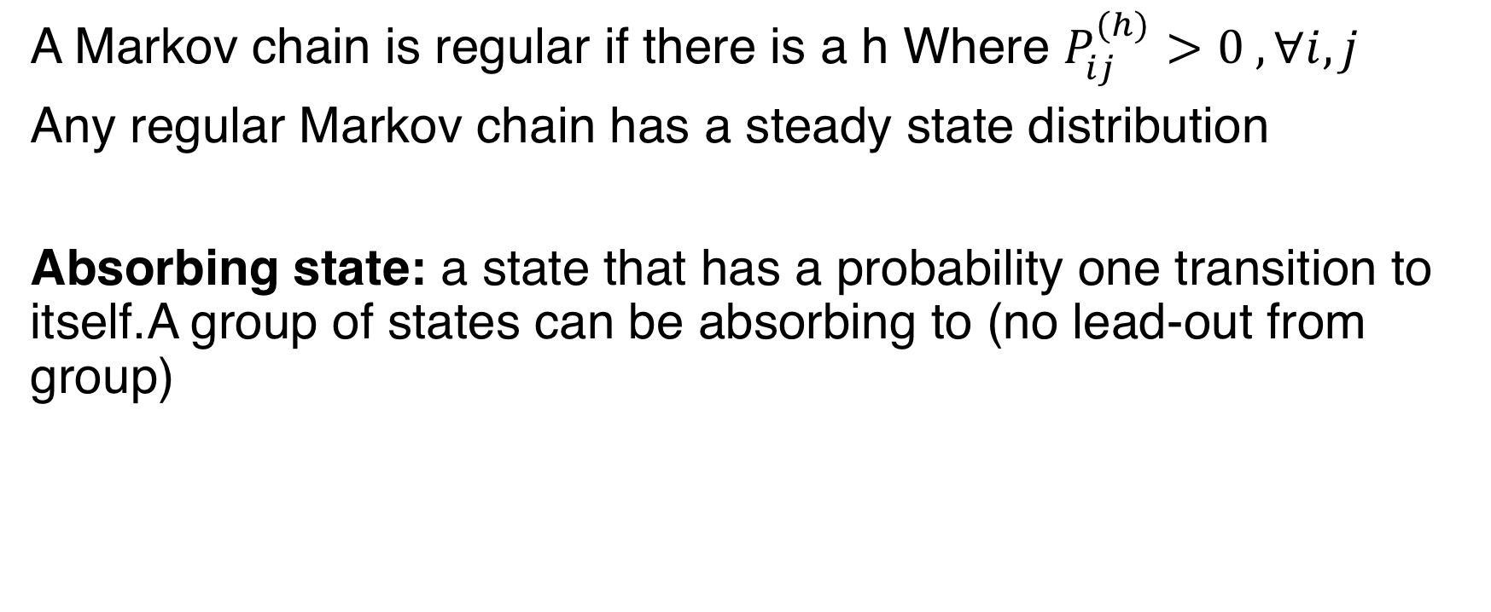
regular Markov Chains
A Markov chain is regular if there is a h Where $P_{ij}^{(h)}>0 , ∀i,j$
Any regular Markov chain has a steady state distribution
Absorbing state: a state that has a probability one transition to itself.A group of states can be absorbing to (no lead-out from group)

Slide 16
Counting Process
A stochastic process X is counting if X(t) is the number of items counted by the time t
As name applies: the state at time t is the number of items counted.
Two major processes:
  Binomial Process
  Poisson Process

Slide 17
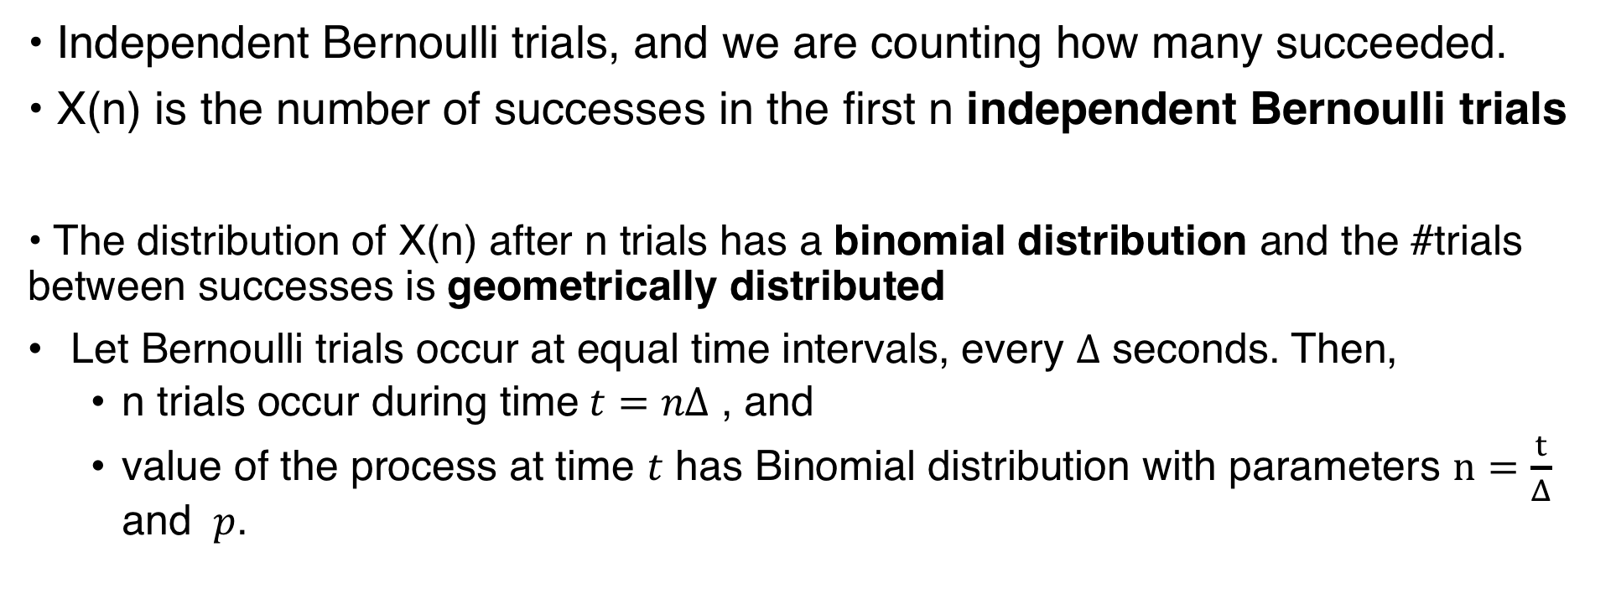
Binomial Process is Markov chain
• Independent Bernoulli trials, and we are counting how many succeeded.
• X(n) is the number of successes in the first n independent Bernoulli trials
• The distribution of X(n) after n trials has a binomial distribution and the #trials between successes is geometrically distributed
Let Bernoulli trials occur at equal time intervals, every $Δ$ seconds. Then,
  n trials occur during time $t=nΔ$ , and
  value of the process at time $t$ has Binomial distribution with parameters $n=\frac{t}{Δ}$ and $p$.

Slide 18
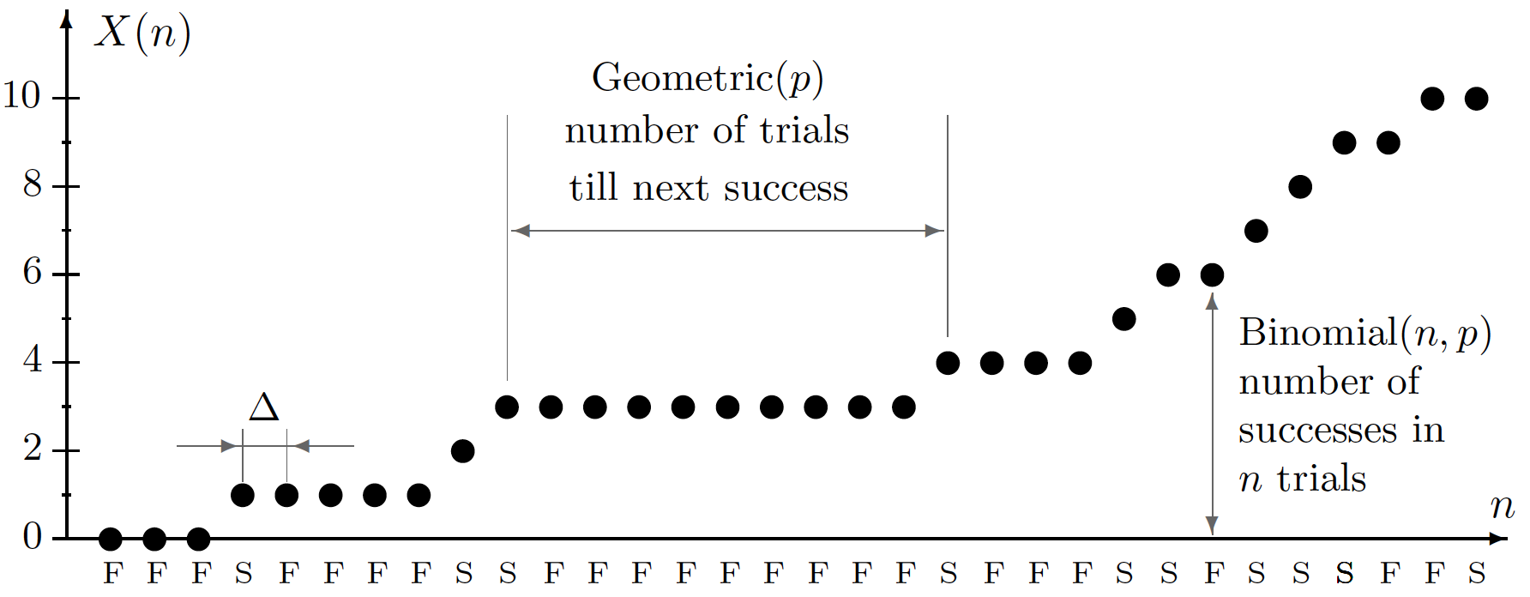
Binomial process (sample path) S = success, F=failure

Slide 19
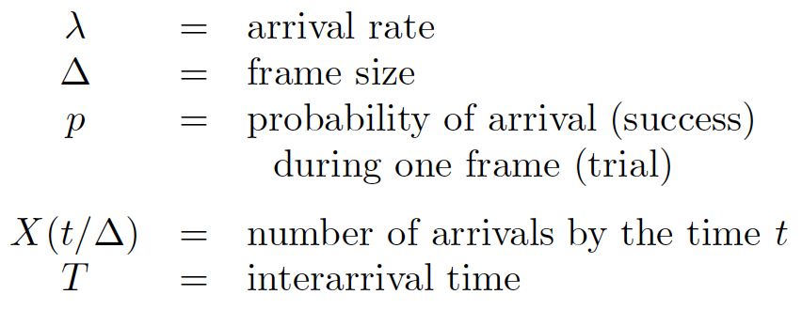
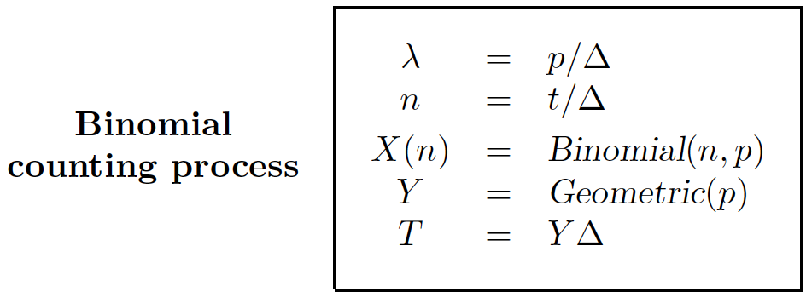
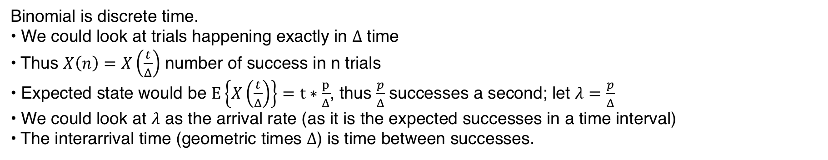
Binomial Counting process (Discrete Time-Discrete State)
Binomial is discrete time.
• We could look at trials happening exactly in $Δ$ time
• Thus $X\left(n\right)=X\left(\frac{t}{Δ}\right)$ number of success in n trials
• Expected state would be $E\left\{X\left(\frac{t}{Δ}\right)\right\}=t∗\frac{p}{Δ}$, thus $\frac{p}{Δ}$ successes a second; let $λ=\frac{p}{Δ}$
• We could look at $λ$ as the arrival rate (as it is the expected successes in a time interval)
• The interarrival time (geometric times $Δ$) is time between successes.

Slide 20
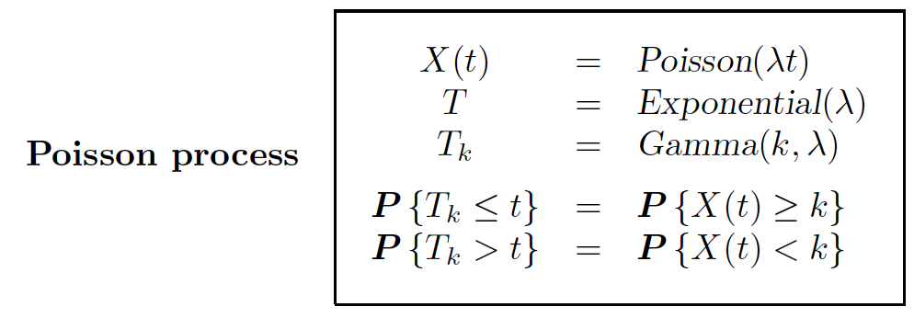
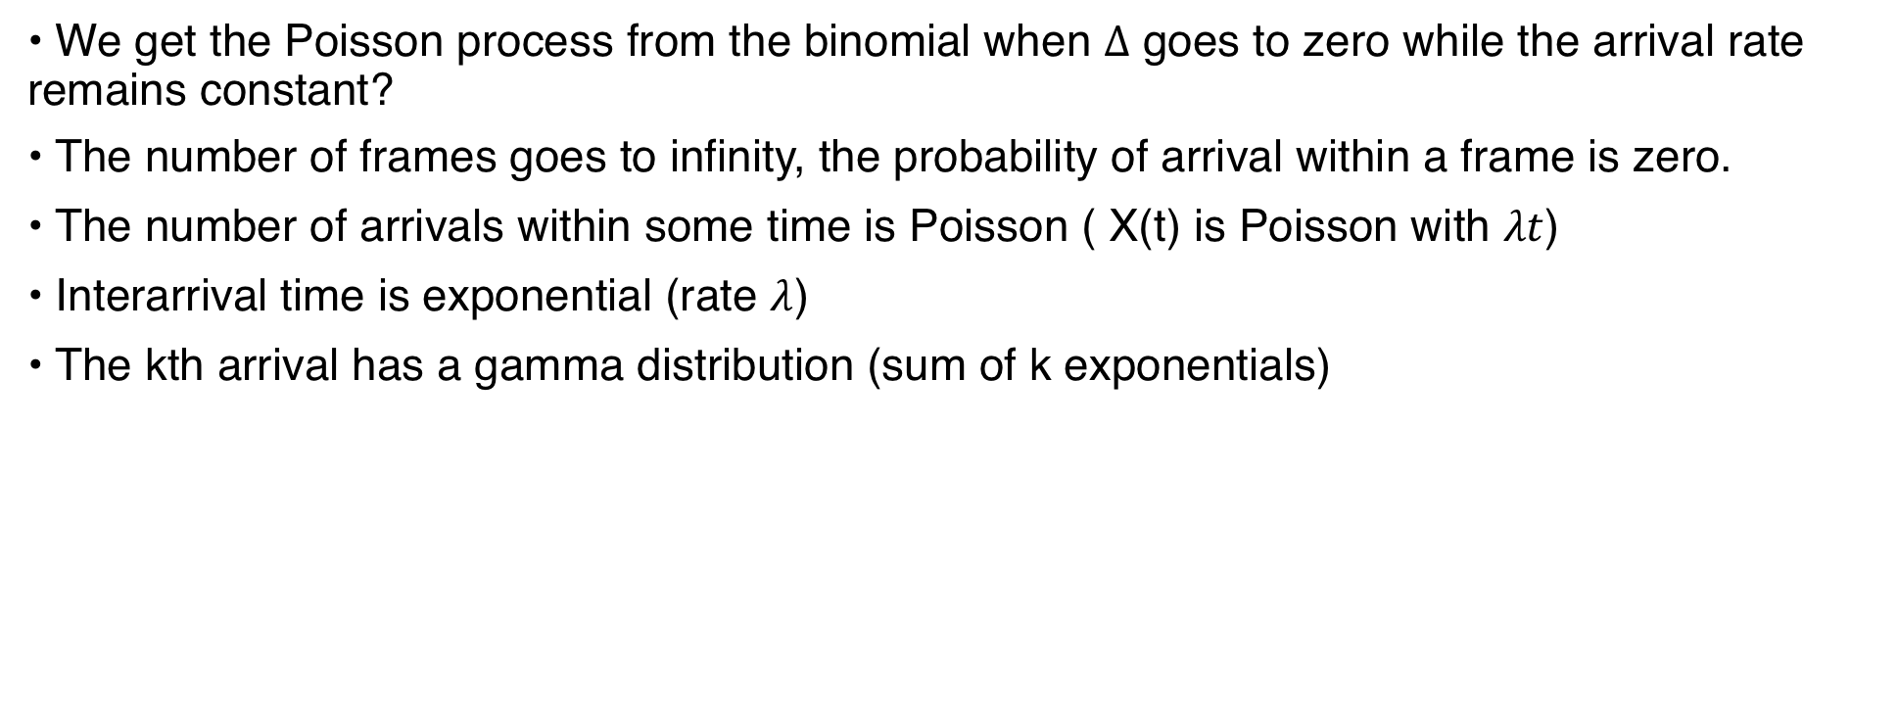
Poisson Process
• We get the Poisson process from the binomial when $Δ$ goes to zero while the arrival rate remains constant?
• The number of frames goes to infinity, the probability of arrival within a frame is zero.
• The number of arrivals within some time is Poisson ( X(t) is Poisson with $λt$)
• Interarrival time is exponential (rate $λ$)
• The kth arrival has a gamma distribution (sum of k exponentials)

Slide 21
Markov Models
Markov models represent a powerful mechanism to model stochastic processes that have finite state and observation sets.
Hidden Markov Models (HMM) provide techniques to automatically
  Evaluate a model
  Predict the underlying state sequence from observations
  Learn a model from observed data
Markov models are more difficult to use if the state space is not finite.

Slide 22
Markov Models
Behavior in general systems can depend on an infinite history
  Potentially infinite memory requirements to store system model
    Infinitely many transition probabilities
    Infinitely many situations have to be stored
Many systems are Markovian and have independent, local observations
  Markov assumption (1-st order Markov):
  Observations only depend on state:

Slide 23
Markov Models
A Markov model represents the behavior of a system (usually with a finite number of states) that has the Markov property
  A Markov model for a stationary process contains:
  <S, O, T, B, Π>
    S={s⁽¹⁾,…,s^{(n)}}: State set
    O={o⁽¹⁾,…o^{(m)}}: Observation set
    T: P(s^{(i)} | s^{(j)}) : Transition probability distribution
    B: P(o^{(i)} | s^{(j)}) : Observation probability distribution
    Π: P(s^{(i)}) : Prior state distribution

Slide 24
Hidden Markov Models (HMM)
The underlying system in a finite state HMM can be represented as a Discrete Markov Model with transition and observation probabilities represented by T and B, respectively.
{ P(o^{(i)} | s⁽³⁾) }
P(s⁽⁴⁾ | s⁽⁴⁾)
{ P(o^{(i)} | s⁽²⁾) }
P(s⁽³⁾ | s⁽²⁾)
P(s⁽⁴⁾ | s⁽³⁾)
S⁽²⁾
S⁽³⁾
S⁽⁴⁾
{ P(o^{(i)} | s⁽⁴⁾) }
P(s⁽¹⁾ | s⁽³⁾)
S⁽¹⁾
P(s⁽⁴⁾ | s⁽¹⁾)
P(s⁽⁶⁾ | s⁽²⁾)
{ P(o^{(i)} | s⁽¹⁾) }
S⁽⁶⁾
S⁽⁵⁾
P(s⁽¹⁾ | s⁽⁵⁾)
{ P(o^{(i)} | s⁽⁶⁾) }
P(s⁽⁵⁾ | s⁽⁶⁾)
{ P(o^{(i)} | s⁽⁵⁾) }
P(s⁽⁵⁾ | s⁽⁵⁾)

Slide 25
Hidden Markov Models (HMM)
In a Hidden Markov Model (HMM) the underlying process (i.e. the state) is not observable
  Observations are linked to the state only through the observation probabilities
  The behavior of the process is assumed to be stationary
HMMs are often used to construct models of a process from observations or to determine unobservable properties from the observations
  Model: λ=(T, B,Π)

Slide 26
HMM – Key Problems
Three problems are of major interest in HMMs:
  Evaluation Problem: How likely is a particular observation sequence?
  Estimation Problem: What is the best state sequence to explain the observed data ?
  Model Construction Problem: What is the best model, λ, to explain the observed data ?

Slide 27
The Evaluation Problem
The main goal of the evaluation problem is to be able to determine the quality of a given model λ
  The quality of the model can be measured in terms of its likelihood to explain (generate) the actually observed data.
  A better model should have a higher likelihood to generate the observed data, i.e. λ₁ is better that λ₂ if

Slide 28
The Evaluation Problem
An intuitive way to solve the evaluation problem is to condition the probability on the state sequence
  This method would have to compute the likelihood of the observation sequence for every possible state sequence and would therefore be O(2Tn^{T})
  This makes it intractable even for relatively concise models

